Slide 1
Get Outside The Box
Laine Paglia

Slide 2
Ice Breaker
Create a bucket list and share with each other what activities you want to accomplish.

Slide 3
What’s Inside?

Slide 4
What is “Work Ethic?”
-A work ethic is a personal set of values that determines how any individual approaches their work.
-Work ethic vs. Effort

Slide 5
Are you holding yourself to a standard?
Drink 2 liters of water each day
Have good hygiene
Listen to music everyday on my way to work

Slide 6
What are your three standards?
Please write down three standards that you try to hold yourself too every day and then once finished, we will share with everyone else.

Slide 7
So how do we manage our self through our work ethic?
We get outside the box!
Complete the work sheet.

Slide 8
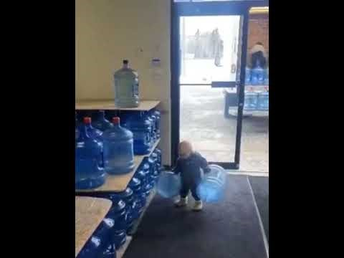
When do we start to form our work ethic?

Slide 9
Playbook
Work with your Big to answer and score yourself on the Work Ethic Participant Playbook.

Slide 10
Match Social
1st thing
  Talk with your Big about any lingering thoughts or feelings you may have.
  Fill out survey
2nd thing
  Connect with the other matches in the room. Here are questions you could ask:
    Who are you?
    What is your background?
    How long have you been matched for?
    What do you and your Little like to do?

