Slide 1
Positively Me
Laine Paglia

Slide 2
Ice Breaker

Slide 3
What's Inside?

Slide 4
What is Self-Concept?
Self-concept is not self-esteem. Self-concept is the perception that we have of ourselves.
What is my Self-Concept you ask?

Slide 5
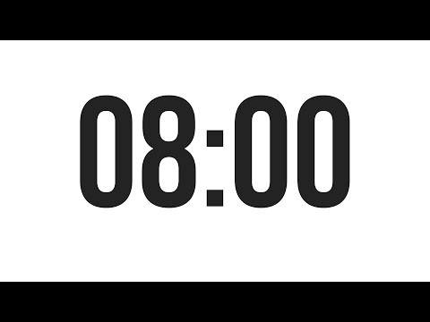
Activity #1
Please find the worksheet in your yellow folder titled “What skills are important for a positive self-concept?”
Follow directions

Slide 6
Activity #2
What Happened
What did I say
What should I say
I got a C on a test that I studied really hard for.
I’m dumb and I just shouldn’t try anymore.
I can always try again and now I know what exactly to study for.

Slide 7
Raffle Break

Slide 8

Match Social
1st thing
  What lingering thoughts and feelings do you still have?
  Fill out Survey
2nd thing
  Connect with the other matches in the room. Here are questions you could ask:
    Who are you?
    What is your background?
    How long have you been matched for?
    What do you and your Little like to do?

