Slide 1
Developing Confidence

Slide 2
Create Your Name Cards
Include a drawing of something your proud of

Slide 3
Opening Video

Slide 4
Who am I?

Slide 5
Activity
Write down all your accomplishments
Write down 3 goals you and your mentor can accomplish together

Slide 6
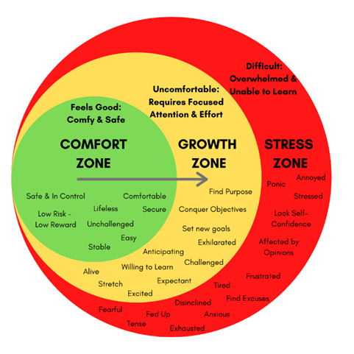
Comfort Zone

Slide 7
Bigs – Share your experience in developing Confidence

Slide 8
Littles – What might you be doing right now that is helping you grow your Confidence?

Slide 9
Please Fill Out The Survey In Your Folder
Once done, please collect your thank you gift card

Slide 10
Thank you

